Slide 1
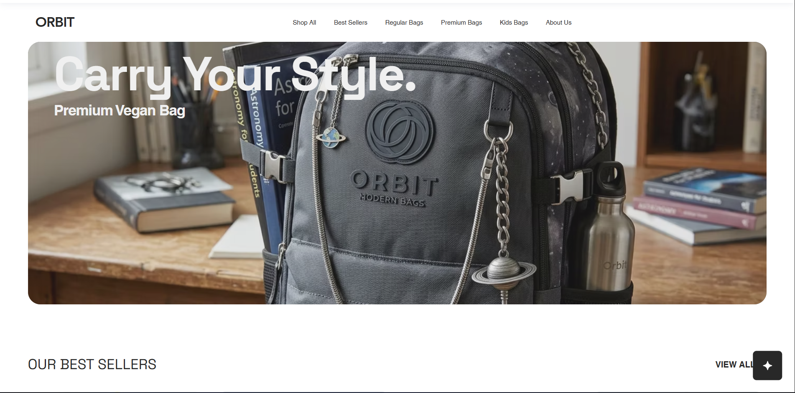

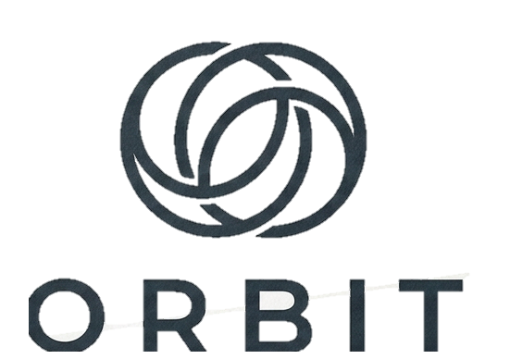
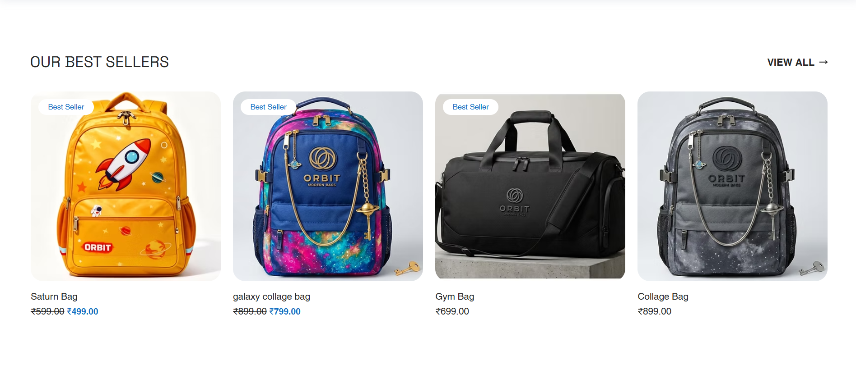
DIGITAL MARKETING ASSIGNMENT
Search Engine Optimization For Orbit
Submitted :- Bhavesh Khemani
BCA 3rd Sem
Section 2025 - 2028

Slide 2

Digital Marketing
Assignment Report
ASSIGNMENT FOLIO
Assignment Folio of
Digital Marketing
Submitted to
Dezyne École College
Toward Digital Marketing
By
BCA
3rd Semester
Bhavesh Khemani
Dezyne École College
106/10, Civil Lines, Ajmer
www.dezyneecole.com

Slide 3
Digital Marketing
Acknowledgement
ASSIGNMENT FOLIO
We take this opportunity to express our sincere gratitude to Dezyne École College for providing us with the knowledge, resources, and guidance essential to the successful completion of this project.
Our deepest thanks to our respected Principal, Dr. Vinita Mathur, for her visionary leadership and continuous encouragement. Her commitment to academic excellence and student growth has been a constant source of motivation and pride.
We are equally thankful to all our faculty members for their consistent support, expert advice, and valuable insights that shaped our learning and helped us achieve this milestone.
Lastly, we extend heartfelt thanks to everyone who directly or indirectly contributed to the success of this project.
We are proud to be part of Dezyne École College, an institution that truly nurtures professionalism, innovation, and purpose.
With sincere appreciation,
Bhavesh Khemani
Department – BCA
Dezyne École College, Ajmer

Slide 4
Digital Marketing
Case Study
ASSIGNMENT FOLIO
SEO Optimization
Objective:
To improve the search engine visibility, organic traffic, and overall website performance of a newly launched website by implementing effective On-Page, Off-Page, and Technical SEO strategies.
Website & Keyword Planning
Analyzed the website structure and performed keyword research to identify primary, secondary, and long-tail keywords based on user search intent (informational, navigational, transactional).
On-Page SEO Implementation
Optimized web pages using SEO-friendly URLs, title tags, meta descriptions, and proper heading structure (H1– H3) to improve relevance and search engine ranking.
Off-Page SEO Activities
Built high-quality backlinks through guest posting, business listings, profile creation, social bookmarking, and forum participation to increase domain authority.
Technical SEO Optimization
Improved page speed, mobile responsiveness, and HTTPS security, to ensure better crawling and indexing.

Slide 5
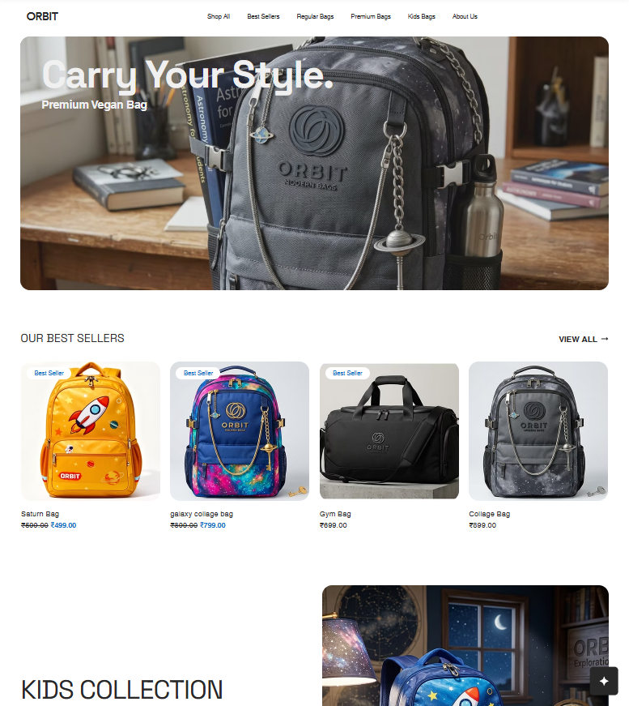
WHY ORBIT
Orbit is a modern backpack brand dedicated to creating stylish, durable, and functional bags for students, professionals, and travelers. Inspired by innovation and exploration, Orbit offers premium-quality school bags, laptop backpacks, and travel bags that combine comfort, smart organization, and contemporary design for everyday adventures and lasting reliability.
Orbit uses Search Engine Optimization to reach customers searching for school bags, travel backpacks, laptop bags, and stylish backpacks online. By targeting relevant keywords, optimizing website content, improving page speed, creating valuable blogs, and enhancing user experience, Orbit increases Google rankings, organic traffic, brand awareness, and online sales.

Slide 6
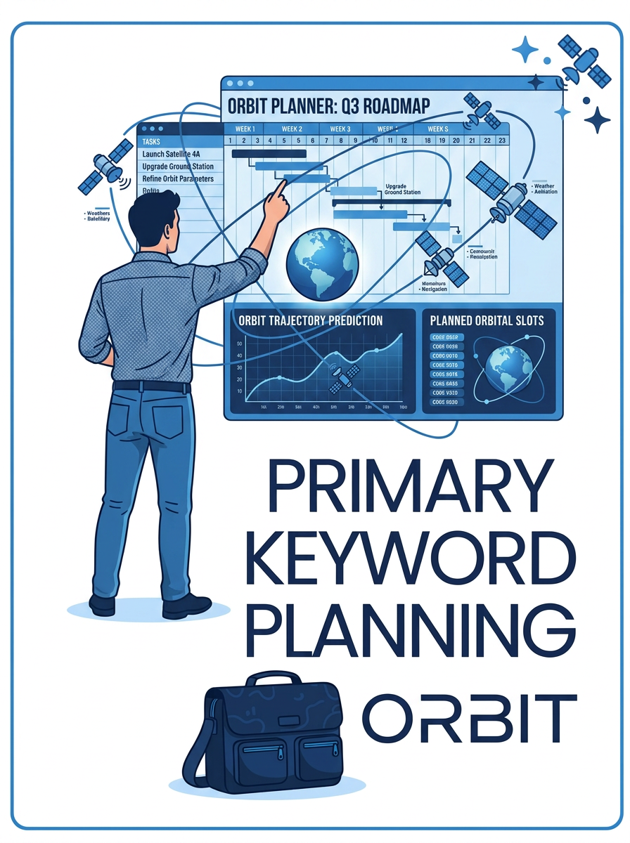
Primary Keywords
Stylish Backpacks
Durable School Bags
Lightweight Backpacks
Water-Resistant Backpacks
College Backpacks
Premium Backpack Brand
Backpacks
School Bags
Laptop Bags
Travel Backpacks

Slide 7
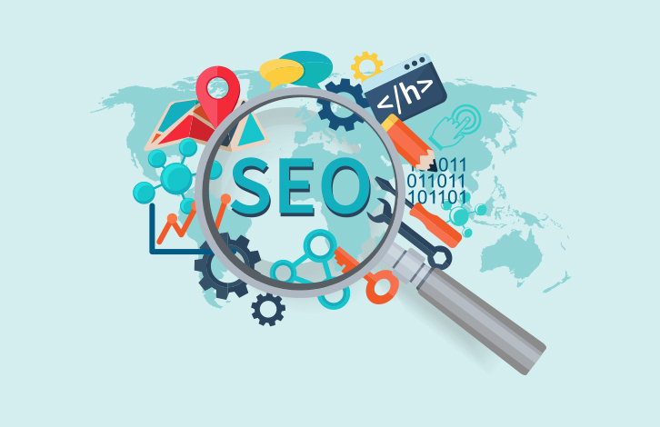
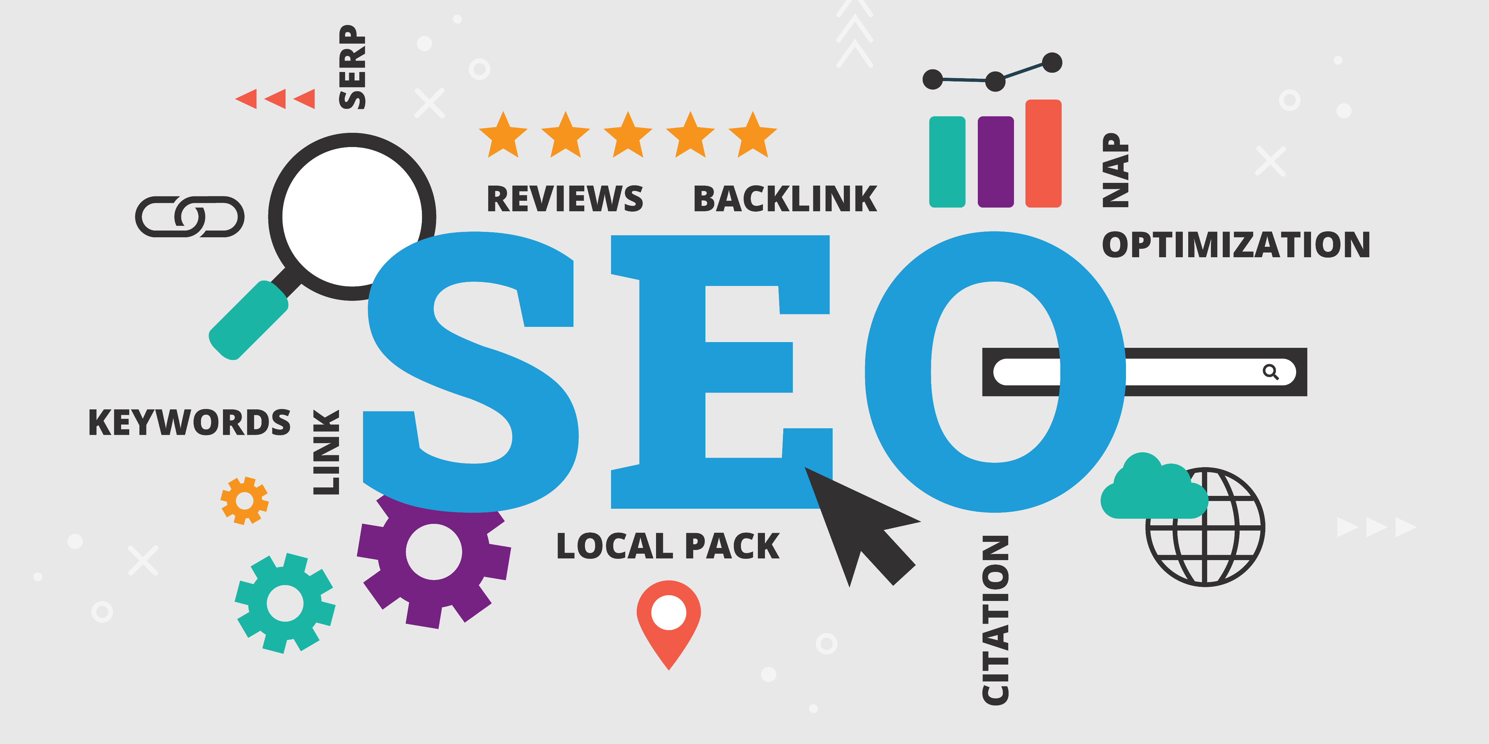
ON-PAGE SEARCH ENGINE OPTIMIZATION
Better Rankings
Higher Visibility
Targeted Keywords
Quality Traffic
PAGE OPTIMIZATION
SEO Friendly URL
SEO Friendly title
Meta Description
Heading
Semantic tags

Slide 8
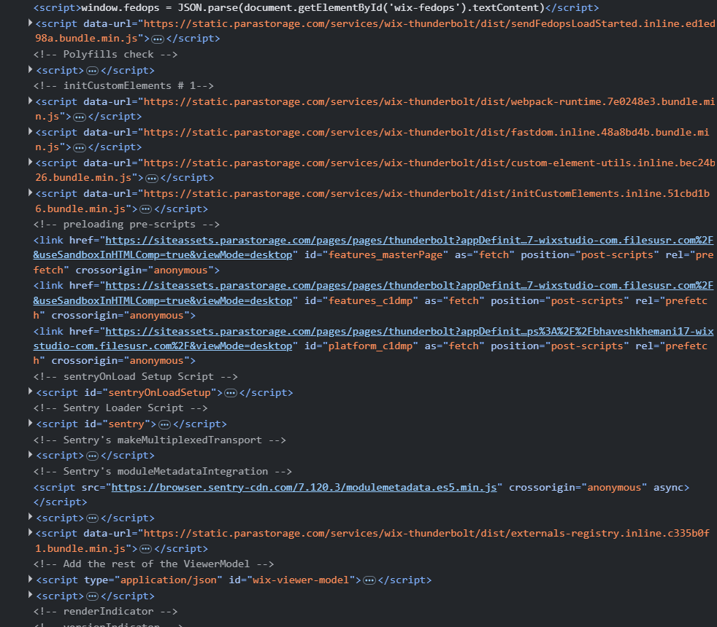
PAGE OPTIMIZATION
SEO-Friendly URL
Short and clean
Easy to remember
Brand-focused
No unnecessary characters
https://www.orbit.com
Title tag
Includes primary keywords
Clear value proposition
Improves CTR (click-through rate)
<title>Home | orbit</title>

Slide 9
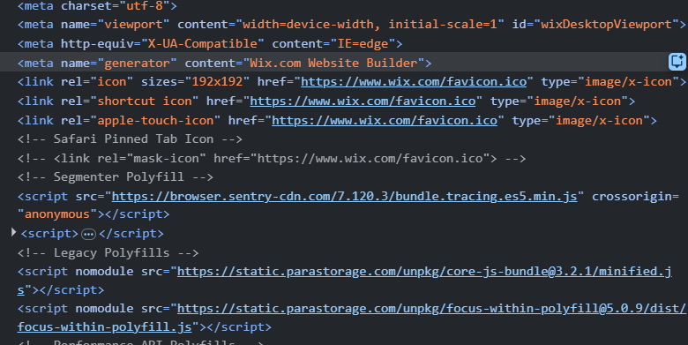
Meta Description
Encourages users to click
Explains the service clearly
Uses important keywords naturally
<meta name="twitter:title" content="Home | orbit">
H1, H2, H3 Structure
Carry Your Style
Our School Bag Collection
Customer Reviews
Lightweight Design
Water-Resistant Material
Comfortable Shoulder Straps
Improves content readability
Helps search engines understand page hierarchy
Enhances SEO crawling and indexing

Slide 10
Semantic Tags & Web Structure
Semantic tags improve accessibility and SEO by clearly defining content structure.
Header – Navigation & logo
Main – Core content
Section – Destinations, stays
Footer – Links, policies
Why Each Optimization Is Done ?
URL: Easy crawling and indexing
Title tag: Ranking & visibility
Meta description: Higher CTR
Headings: Content clarity
Semantic tags: Better user experience & SEO

Slide 11
OFF-PAGE SEARCH ENGINE OPTIMIZATION
External Optimization
Website Promotion
Backlink Building
Brand Authority
BACK LINKING
Backlinking is the process of getting links from other websites to your website to improve SEO, authority, and search engine rankings
Higher Rankings
Increased Traffic
Better Authority
Faster Indexing

Slide 12
GUEST POSTING
Writing and publishing content on another website or blog to gain exposure, build backlinks, and improve SEO
SOCIAL MEDIA MARKETING
Social Media Marketing is the process of promoting a business, brand, product, or service through social media platforms to increase brand awareness, engagement, and sales

Slide 13
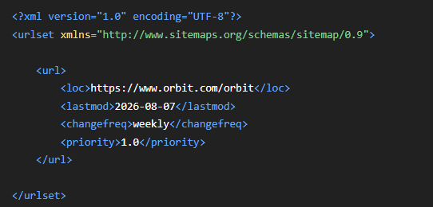
TECHNICAL SEO
XML Sitemap

Slide 14
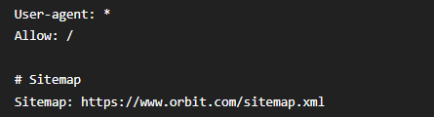
TECHNICAL SEO
Robot.txt

Slide 15
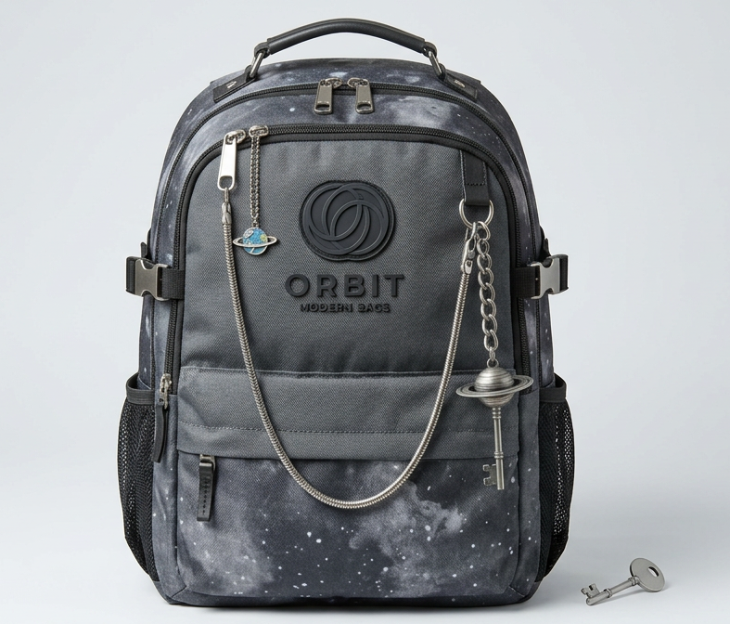
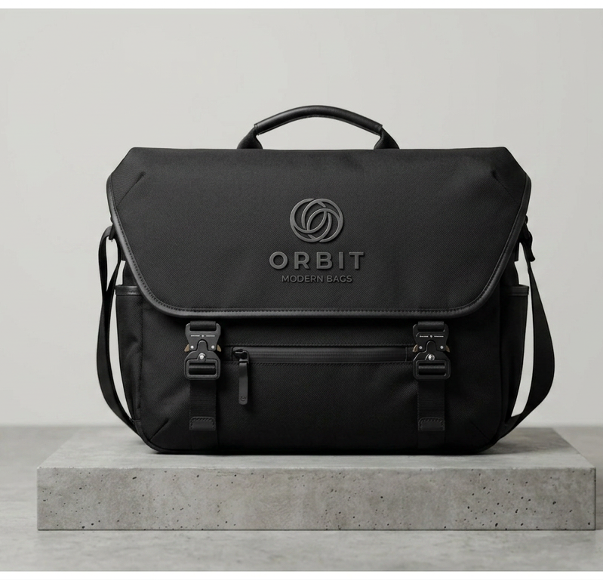
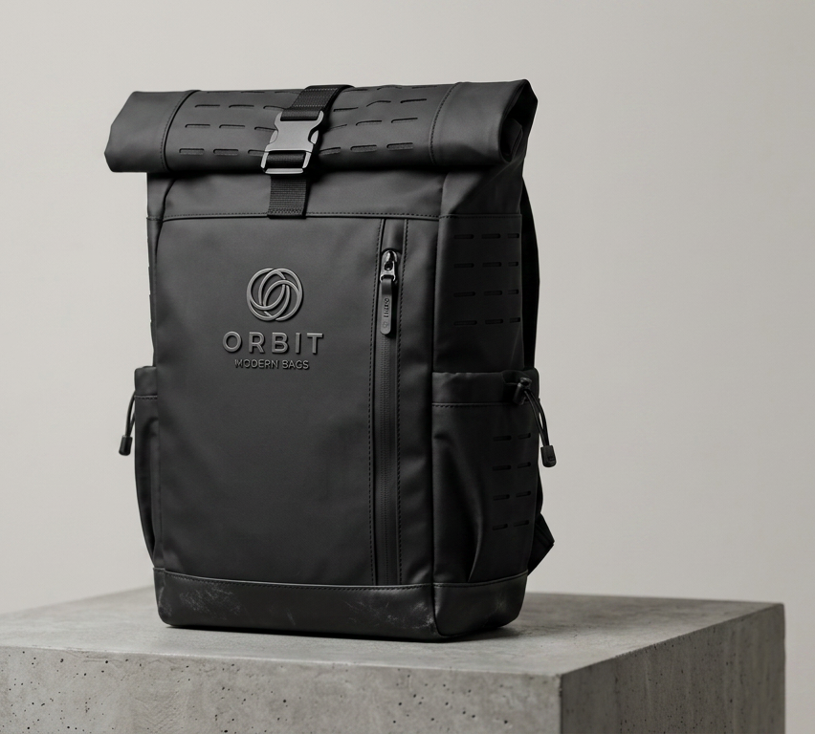
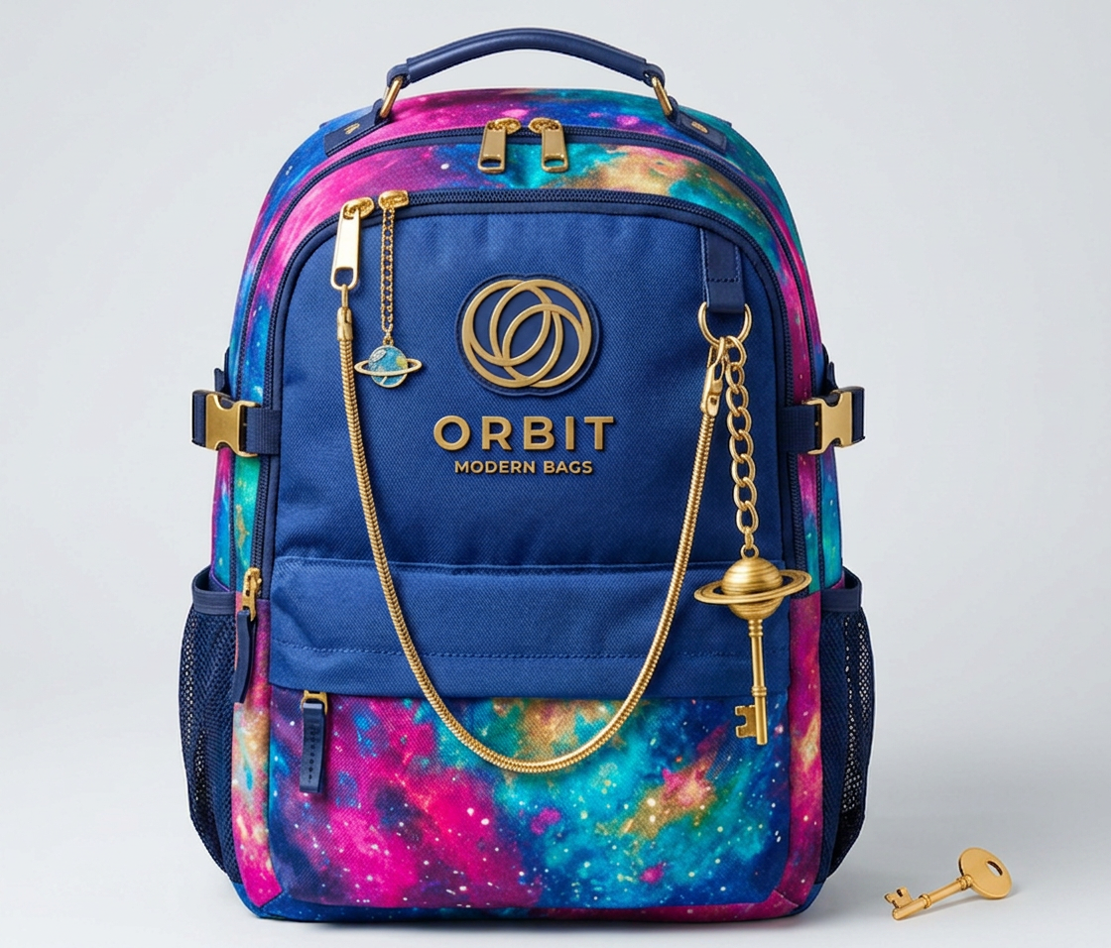
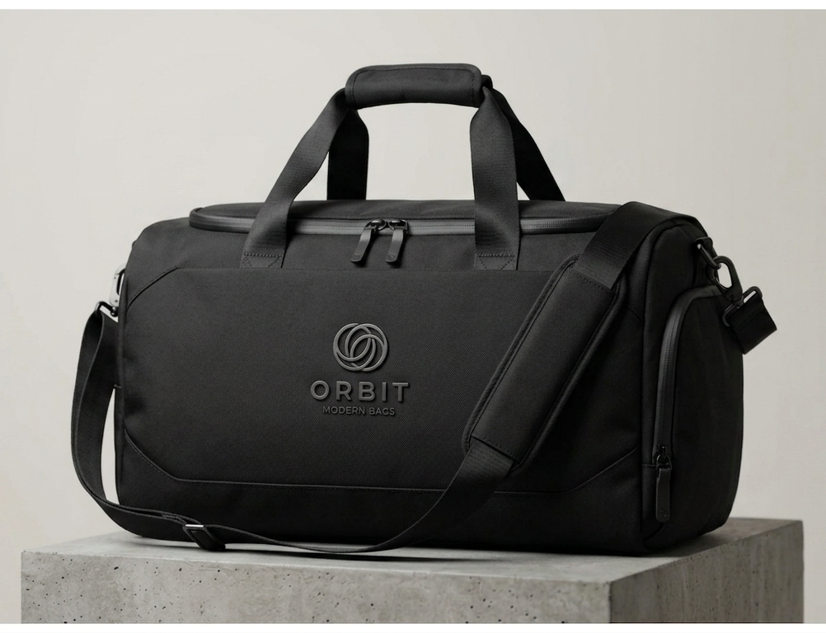
CONCLUSION
Search Engine Optimization (SEO) is an essential part of building a successful online presence. Through proper keyword research, optimized content, SEO-friendly website structure, and effective metadata, a website can achieve better visibility on search engines.
This project helped us understand how SEO improves organic traffic, user experience, and search rankings. Implementing these techniques for Orbit demonstrates how a well-optimized website can reach the right audience and build a stronger digital presence.
Overall, SEO is a continuous process that requires regular analysis, updates, and improvement to achieve long-term results.

